Slide 1
Analysis Of Crime Data Recorded In 2014

Slide 2
Introduction:
My project is crime data analysis according to each district which is recorded in 2014.I collected this dataset from kaggle. It has 803 Rows and 88 columns. It consists the data of what type of crime has been done and how many same type of that crime had been done in that district. The analysis helps us to understand which district has highest crime recorded in 2014 and in which district more murder, rape, dowry deaths, rash driving, kidnapping, forgery, riots, robbery’s had been recorded.

Slide 3
Source Of Dataset:
KAGGLE is an online community of data scientists and machine learners, owned by Google. Kaggle allows users to find and publish data sets, explore and build models in a web-based datascience environment, work with other data scientists and machine learning engineers, and enter competitions to solve data science challenges. Kaggle got its start by offering machine learning competitions and now also offers a public data platform, a cloud-based workbench for data science, and short-form AI education. On 8 March 2017, Google announced that it was acquiring Kaggle.

Slide 4
Analysis on Dataset:
To Find The Top 10 States Where Highest Crime Is Recorded.
To Find In Which District Highest Murders Recorded.
To Find In Which District Highest Rapes Recorded.
To Find In Which District Highest Dowry Deaths Recorded.
To Find In Which District Highest Robbery’s Recorded.
To Find In Which District Highest Forgery Recorded.
To Find In Which District Highest Kidnapping Recorded.
To Find In Which District Highest Riots Recorded.
To Find In Which District Highest Rash Driving Recorded.
Notes:
1st state is Madhya Pradesh
Patna has highest murders
Mumbai has highest rape and robbery and forgery
Muzaffurpur dowry deaths
Outer delhi kidnaps
South 24 parangas west Bengal riots
Trissur rural rash driving

Slide 5
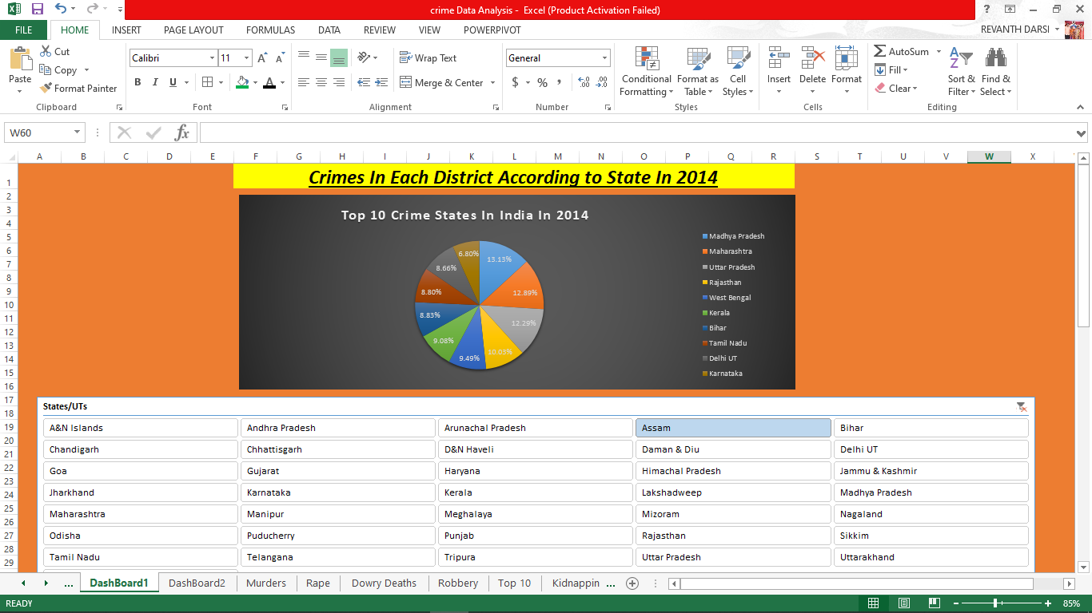
Dashboard:
Each and every analysis result is clearly seen in the dashboard.
As we are using dynamic slicer there is no need to change state in every graph.

Slide 6
Scope:
As Slicer in Dash Board is dynamically linked so if you make any changes in dashboard then each and every graph linked to it changes and repels the same in dashboard.
We can easily know in which state which district had highest crime recorded by looking the dashboard and We can tell total number of crimes done in that district and state.

Slide 7
References:
https://www.kaggle.com/kracekumar/crime_analysis.
https://en.wikipedia.org/Crime_analysis.
https://data.gov.in/dataset-group-name/crime-Statistics.
https://knoema.com/atlas/India/topics/Crime-Statistics/datasets.

